Slide 1

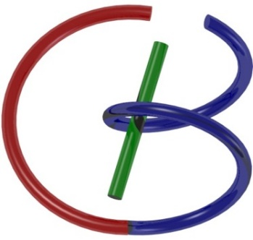
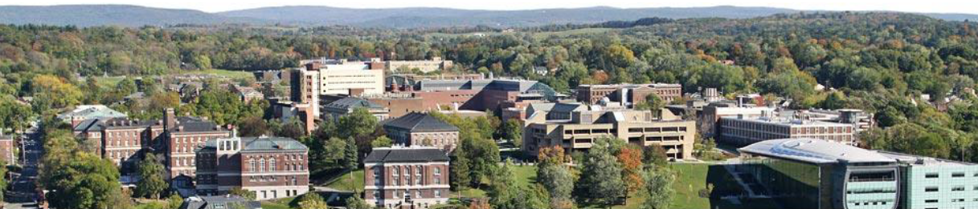
Hands-on 5 Disentanglement
Ge Wang
AI-based X-ray Imaging System (AXIS) Lab
Rensselaer Polytechnic Institute, Troy, New York, USA
November 23, 2021

Slide 2
MI Schedule for F21
Tue | Topic | Fri | Topic
08/31 | Introduction | 09/03 | Neuron, Network & Backpropagation
09/07 | No Class | 09/10 | Hands-on 1: Python, Colab, & TensorF
09/14 | Architectures & Training | 09/19 | Hands-on 2: MNIST Classification
09/21 | Image Quality I | 09/24 | CT Physics
09/28 | CT Reconstruction | 10/01 | Deep CT Reconstruction
10/05 | Hands-on 3: CT Networks | 10/08 | More CT Contents
10/12 | MRI Physics | 10/15 | Spin-Echo
10/19 | K-Space Theorem | 10/22 | More MRI Contents
10/26 | Mid Exam | 10/29 | Deep MRI Reconstruction
11/02 | Hands-on 4: MRI Networks | 11/05 | Nuclear Physics
11/09 | Nuclear Imaging | 11/12 | US Imaging
11/16 | Optical Imaging | 11/19 | Multimodality Imaging
11/23 | Hands-on 5: Image Conversion | 11/26 | Thanksgiving
11/30 | Image Quality II | 12/03 | Stability, Interpretability, & Others
12/07 | Overview | 12/10 | Final Exam
Office Hour: Teaching Day 5-6pm: https://rensselaer.webex.com/meet/wangg6

Slide 3
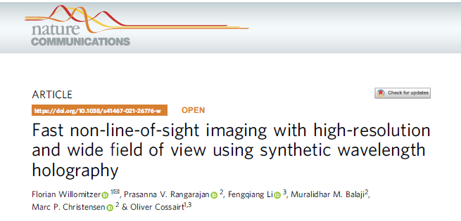
Synthetic Wavelength Holography

Slide 4
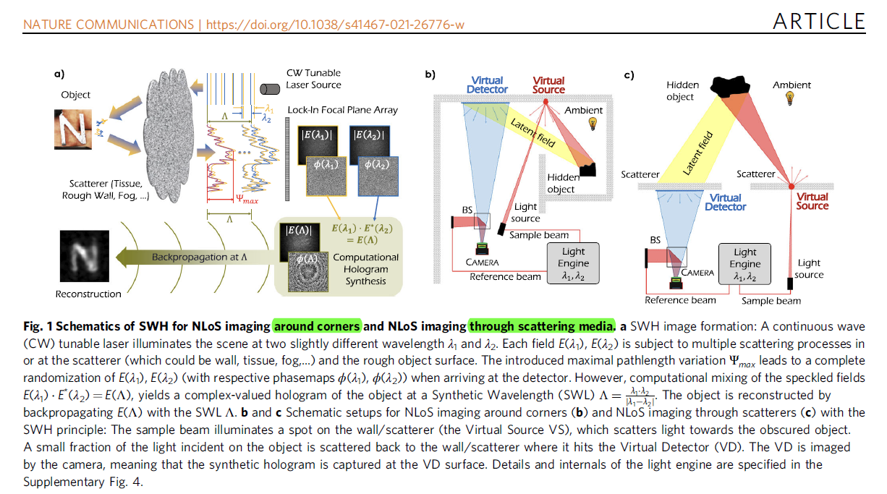

Slide 5
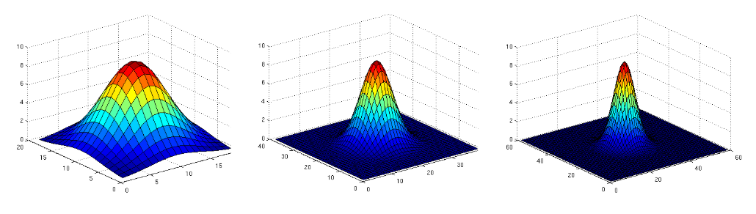
Entanglement Examples
Z=X+Y (If 100=X+Y, X=1, Y=99? Or X=2, Y=98?)
G
g₁
g₂
G = g₁ ◦ g₂
Output = Input ◦ G = (Input ◦ g₁) ◦ g₂

Slide 6
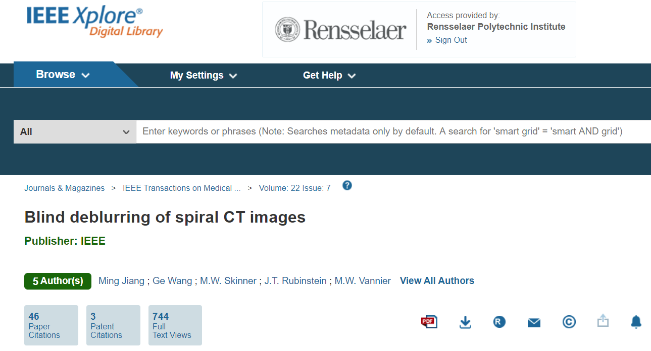
Blind Deblurring of CT Images

Slide 7
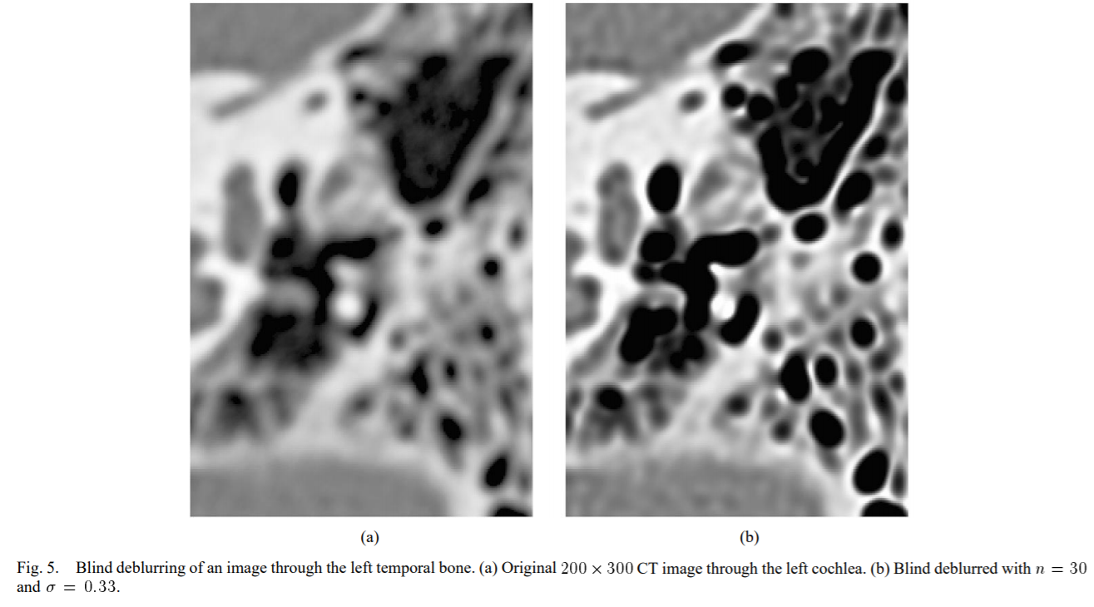
Our Result in 2003

Slide 8
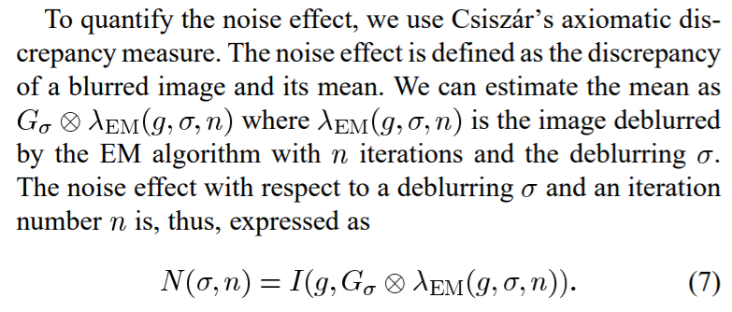
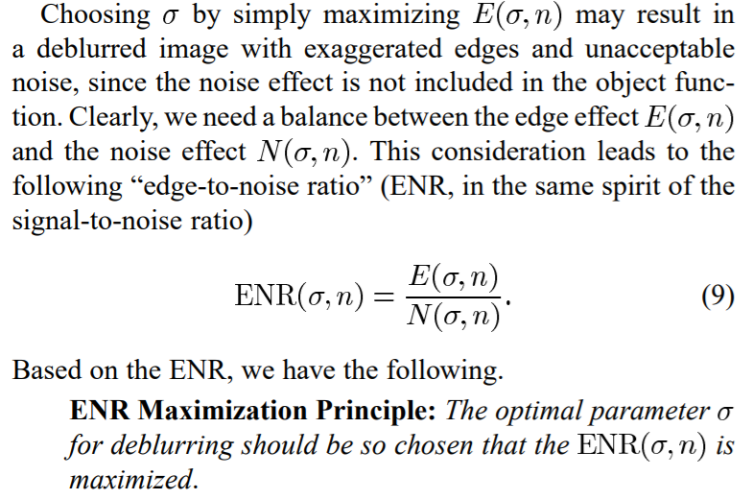
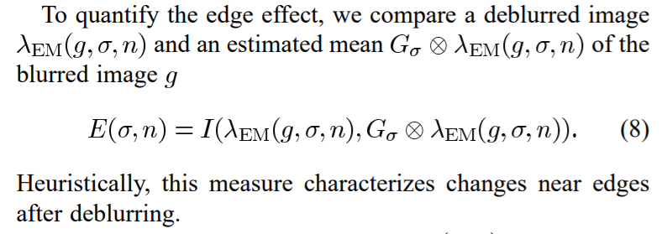
Edge-to-Noise Ratio (ENR) Maximization

Slide 9
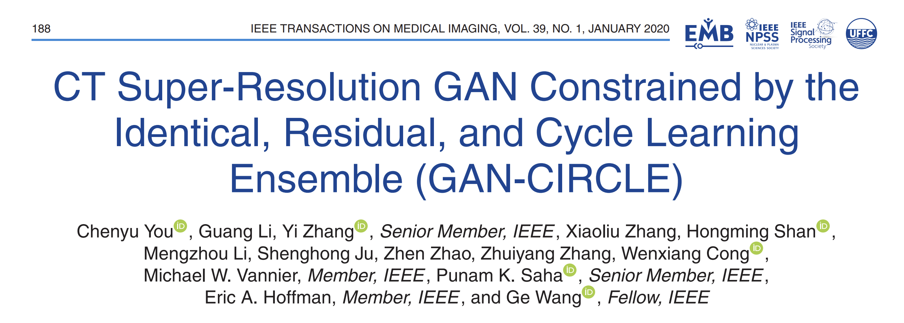
Flagship Journal TMI

Slide 10
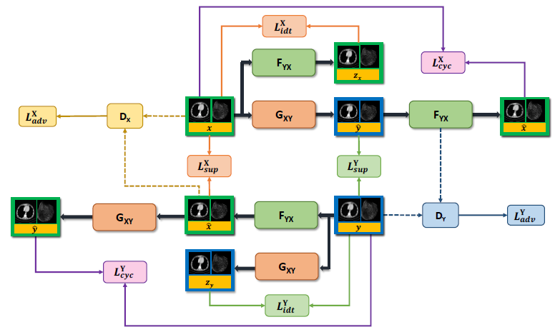
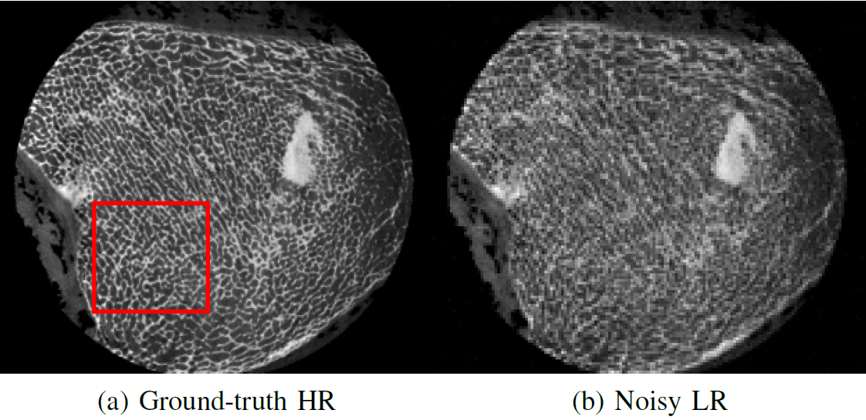
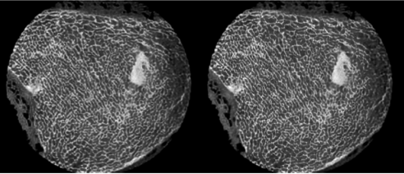
Low-cost CT Deblurring: GAN–CIRCLE
Truth
Low-resolution
Supervised
Semi-supervised

Slide 11
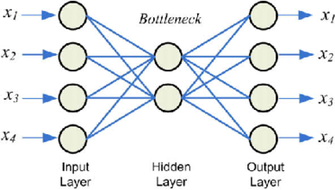
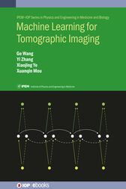
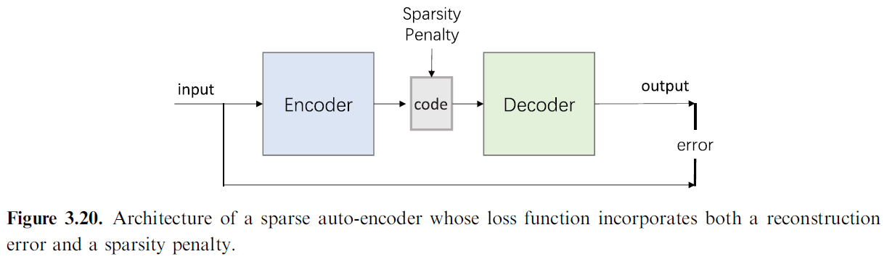
Review: Auto-encoder Idea

Slide 12
Review: GAN Idea
Tuning
Real
Network Output
Input
Generator
Discriminator
Loss
Ground Truth
Synthetic
Tuning

Slide 13
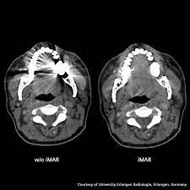
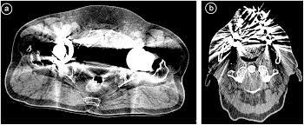
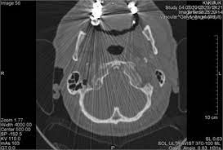
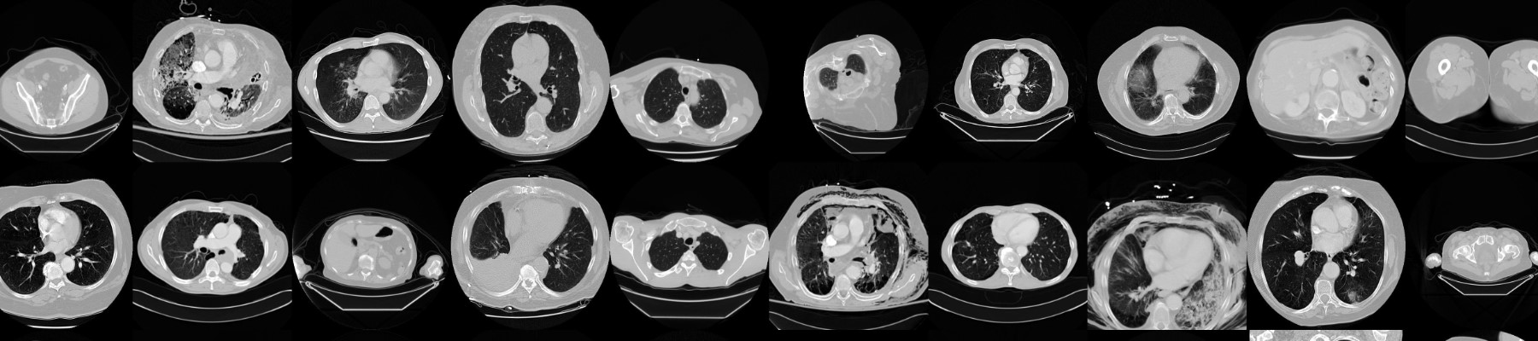
Semi-supervised Learning: Unpaired Datasets
Artifacts in Images
Normal CT Images

Slide 14
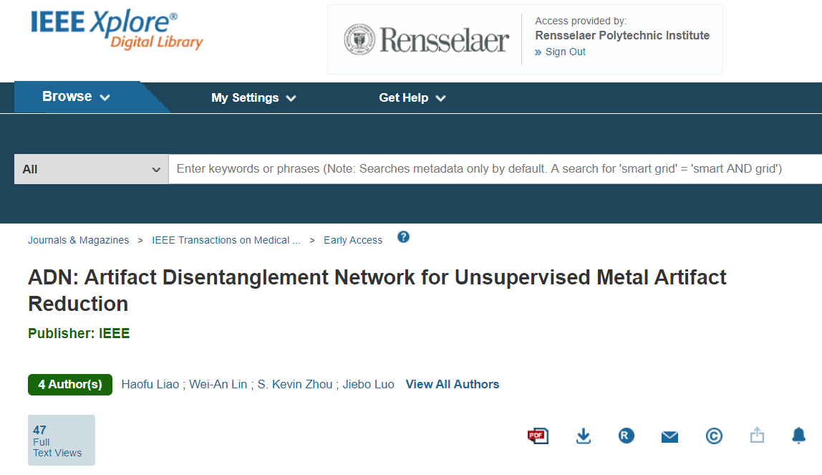
TMI: Artifact Disentanglement Network (ADN)

Slide 15
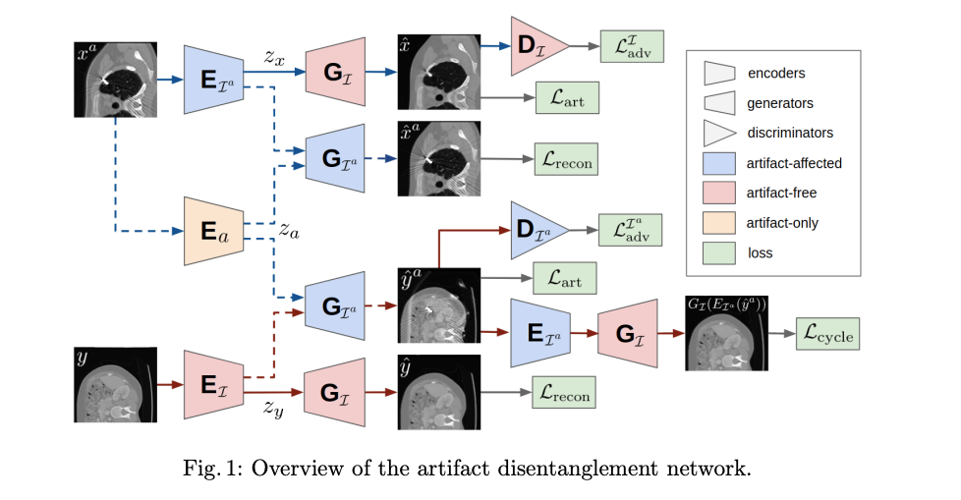



One Puzzle: Disentanglement (“Overwhelmed”)

Slide 16
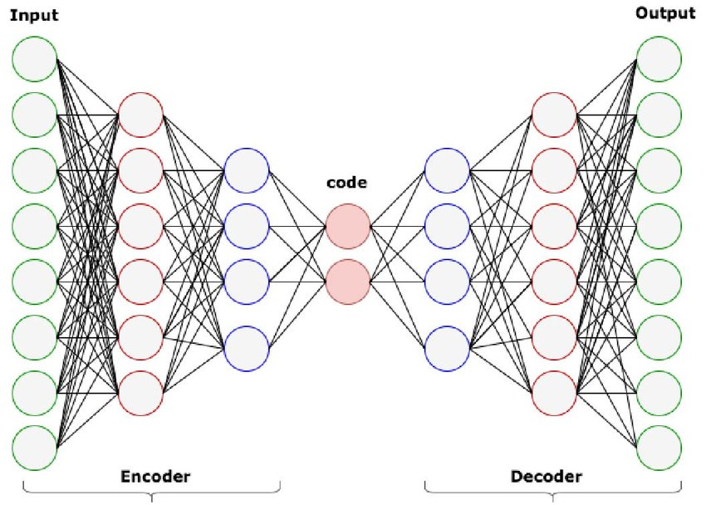
Two Coders: Encoder & Decoder

Slide 17
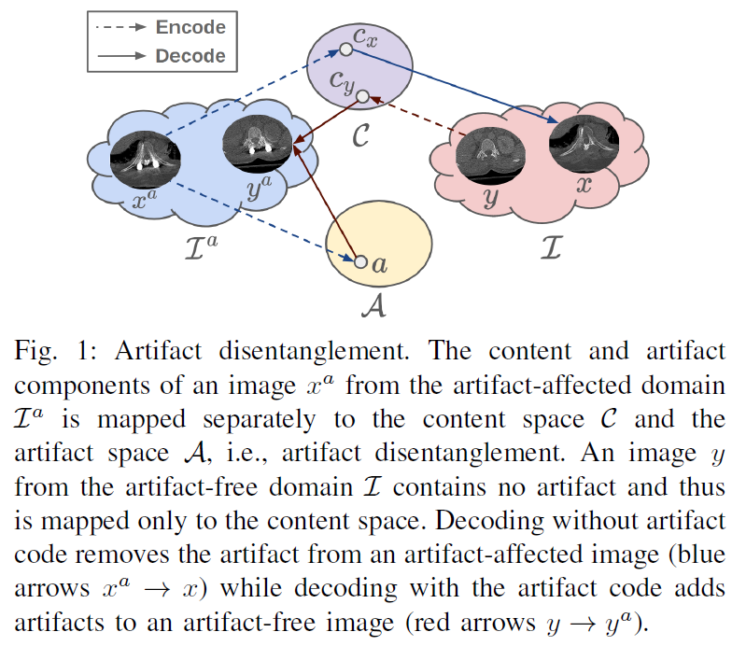
Three Spaces
I: Image Space (Iª and I)
A: Artifact Space
C: Content Space
Encoder: Images to code/features
Decoder: Code/features to images
In the supervised case, all mappings/networks can be obtained from labeled big data, so they do exist!

Slide 18
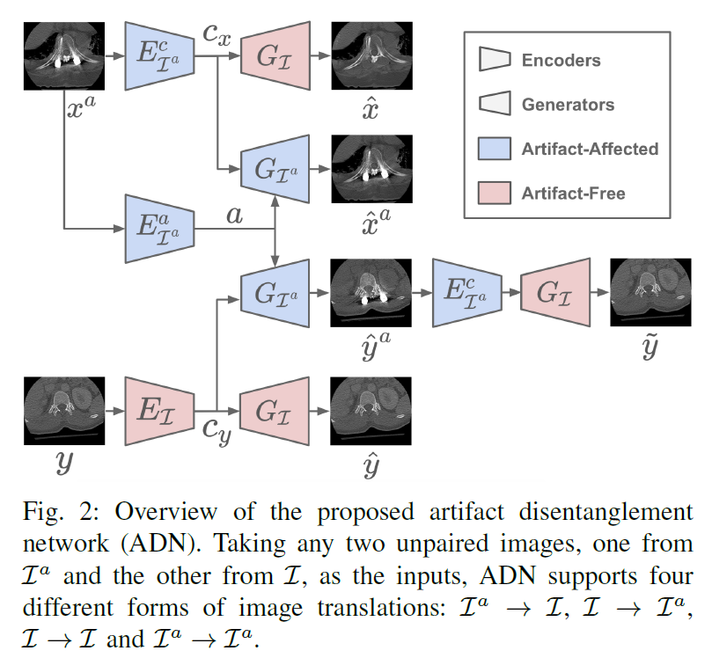
Four Transforms
Four Transforms (Translational Processes) in the Image Domain:
Iª: Image with Artifacts
I: Image w/o Artifacts
All translational networks are trained in the encoder-decoder format with unpaired data.
 | Iª | I
Iª | * | *
I | * | *

Slide 19
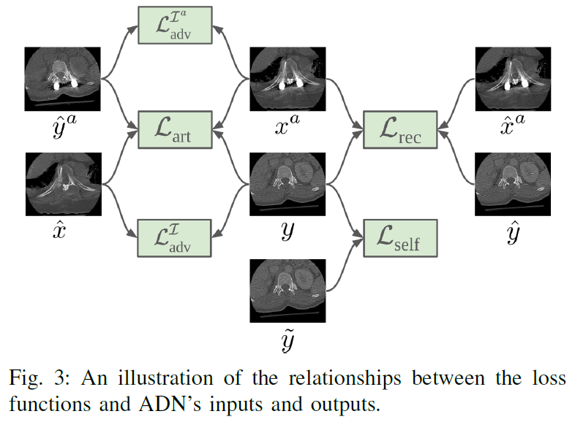
Five Losses
Adversarial Loss in I
Adversarial Loss in Iª
Reconstruction Loss
Artifact Consistency Loss
Self-Reduction Loss

Slide 20
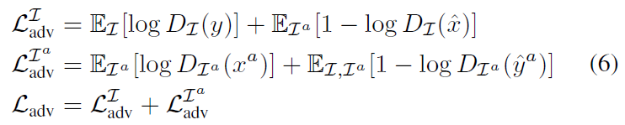
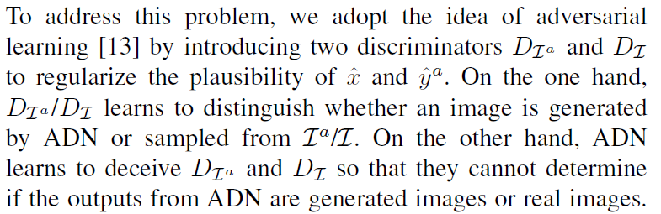
Adversarial Losses
1
0
1
0

Slide 21
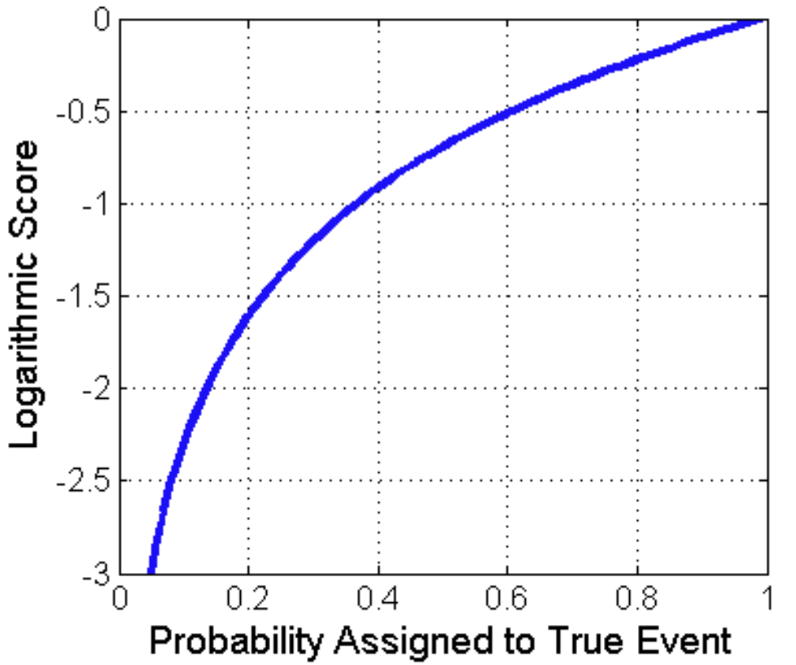
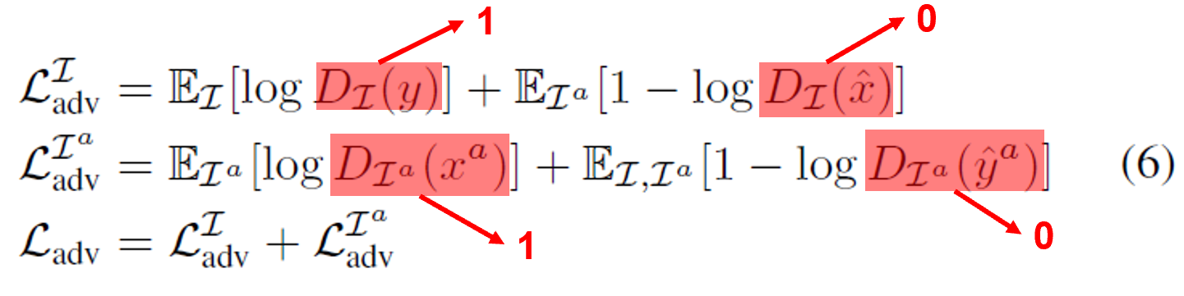
Log Probability log(p): if p=1, log(p) is maximized

Slide 22
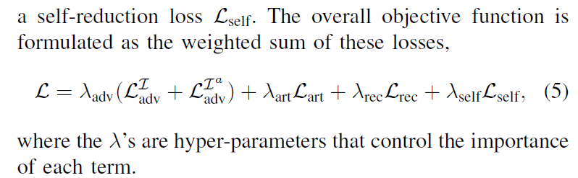
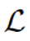
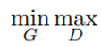
Min Max Problem

Slide 23
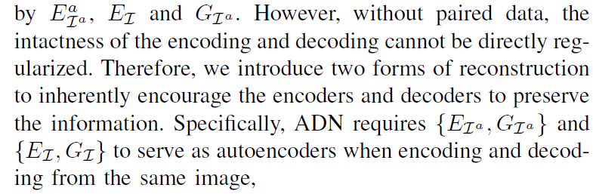
Reconstruction Loss

Slide 24
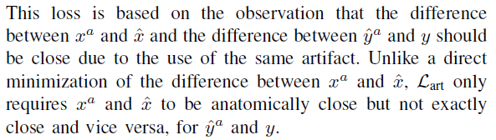
Artifact Consistency Loss

Slide 25
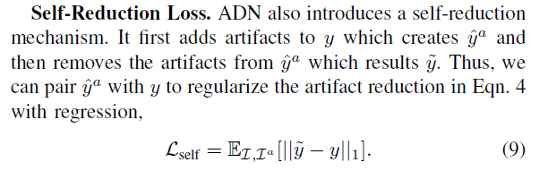
Self-Reduction Loss

Slide 26
Self-Reduction in Both Ways!

Slide 27
Use of Prior Knowledge
Disentanglement Remains Challenging!
100=X+Y plus that X and Y are prime numbers:
2,3,5,7,11,13,17,19,23,29,31,37,41,43,47,53,59,61,67,71,73,79,83,89,97

Slide 28
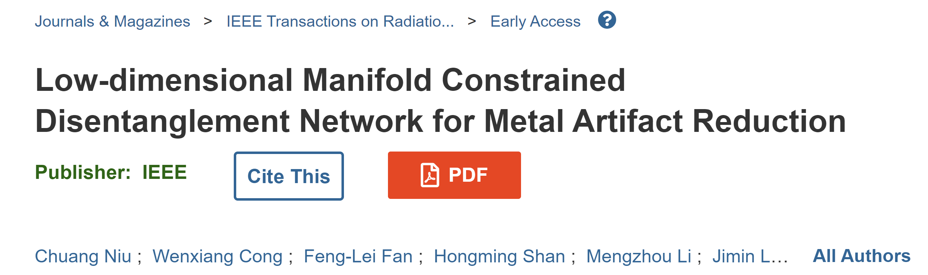
Our Latest Paper to Improve ADN

Slide 29
Homework
Read the ADN paper in the dropbox (#10).
Write a blog article to explain the idea (an example, https://npjscilearncommunity.nature.com/posts/suppressing-the-chance-to-cheat-in-online-exams)

Slide 30


